Slide 1

Introduction to AI (AI101B) AI Based Number Guessing Game Session 2024-25
SAQIB MEHDI - 202410116100185
SANGAM KUMAR - 202410116100181
SATYAM GUPTA - 202410116100186
RAM DUBEY- 202410116100160
Project Supervisor:
Ms. Komal Salgotra
ASST. PROFESSOR

Slide 2
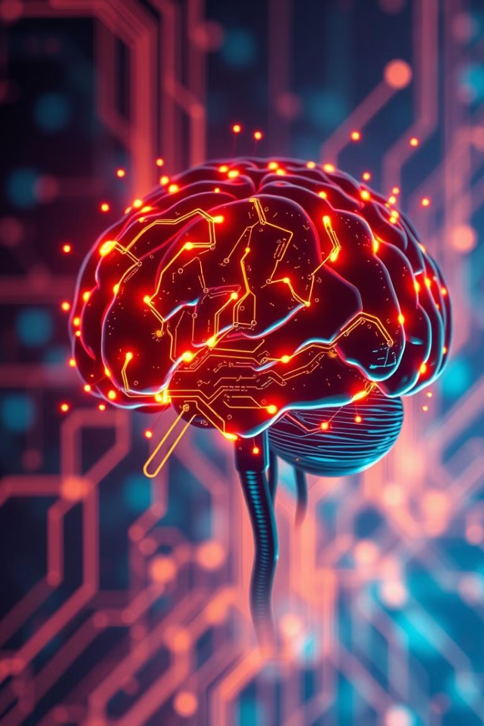

AI Number Guessing: Smart Search Strategies
Explore an intelligent algorithm designed for efficient number prediction. This presentation covers the fusion of random and binary search techniques, visualized using matplotlib. Discover how AI optimizes search strategies for superior performance.

Slide 3
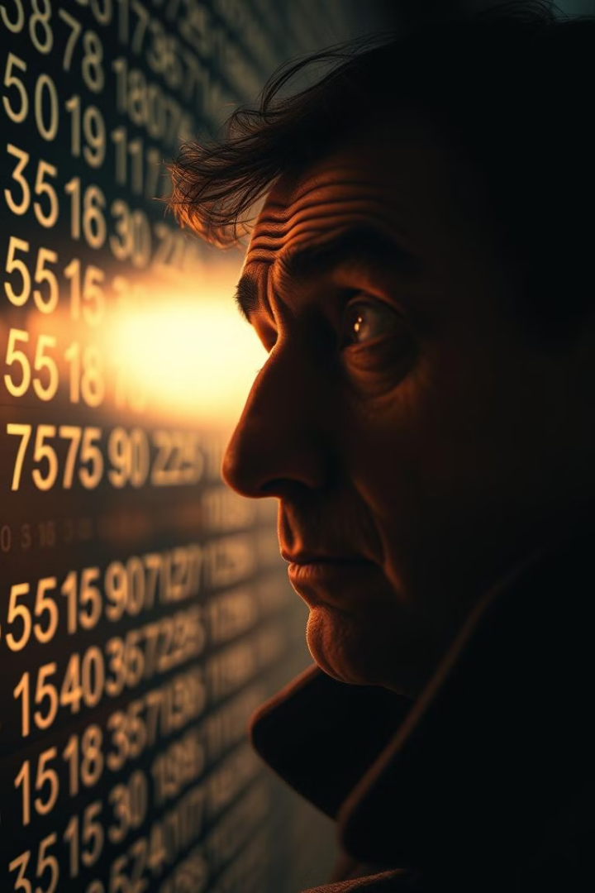



The Challenge of Number Guessing
Traditional guessing methods are often inefficient. AI offers advanced optimization. Our goal is to reduce the number of attempts needed to guess the correct number.
Inefficiency
Optimization
Traditional approaches are time-consuming.
AI enhances search strategies.
Minimization
Minimize guess attempts with AI.

Slide 4
Random Binary Search Algorithm
A divide-and-conquer approach using probabilistic selection within the search range. The algorithm features logarithmic time complexity O(log n) and adapts to improve search efficiency.
Divide and Conquer
Probabilistic Selection
Logarithmic Time
Breaks down the problem.
Selects midpoints randomly.
Efficient scaling.

Slide 5




Algorithm Flow Diagram
The process begins with defining an initial range. Next, a probabilistic midpoint is selected, which narrows the search space, converging on the target number.
Initial Range
Define search boundaries.
Midpoint Selection
Choose a random point.
Narrowing Space
Reduce search area.
Convergence
Reach target number.

Slide 6



Matplotlib Visualization Techniques
Track search progress in real-time and graph attempt count versus accuracy. Compare different search strategies visually for interactive performance visualization.
Graphing Accuracy
2
Visualize performance data.
Real-time Tracking
1
Monitor progress live.
Strategy Comparison
3
Evaluate different methods.

Slide 7
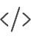


Python Implementation
Review the code structure, matplotlib integration, and sample code snippets. Consider error handling and edge cases for robust implementation.
Code Structure
Organize your code.
Matplotlib
Visualize performance.
Error Handling
Manage edge cases.

Slide 8

Future Improvements and Applications
Explore machine learning enhancements and adaptive search algorithms. Consider potential applications in broader optimization problems and expanding beyond number guessing.
ML Enhancement
Adaptive Search
Integrate machine learning.
Develop smarter algorithms.
Optimization
Apply to new problems.

